Slide 1
MAIN PROJECT - 345
RECOMMENDER SYSTEM USING CONTENT-BASED FILTERING METHOD
180030154 – A SAI KOUSHIK
180030659 – G SRI CHARAN

Slide 2
ABSTRACT
Searching for information on a large website can be time-consuming and complicated. Recommender systems can assist users in locating information by making customized recommendations. Recommendation systems, are a type of data separating framework that predicts the user's 'assessment' or 'preference' for a given item.
Content-based recommendation systems attempt to suggest items that are comparable to those that a user has previously enjoyed. Indeed, a content-based recommender's core method entails comparing the properties of a user profile, which stores preferences and interests, with the attributes of a content object (item), in order to suggest new interesting items to the user.
This project provides an overview of the content-based filtering technique, which is used in E-commerce websites and Online data from social media to harvest data from various users and then use that data to improve Recommender systems.
We represent that our techniques outperform an existing social-filtering method in the domain of movie recommendations on a dataset of more than 100236 movie ratings collected from a community of over 600 users.

Slide 3
CONTENT-BASED FILTERING
Content-based filtering, sometimes referred to as cognitive filtering, suggests items based on a comparison of the item’s content and a user profile. Each item's content is represented by a set of descriptors or terms, which are often words found in a text.
The user profile is described in the same words and is created by assessing the content of items that the consumer has viewed. The user will be recommended things that are basically connected to the positively rated items.
In order to create useful suggestions, Content Based Filtering employs a variety of models to discover similarities between documents. Because other user’s profiles do not influence recommendation, the content-based filtering technique does not require them.
Further, if the user profile changes, the Content Based Filtering approach may still alter its recommendations in a very short amount of time.
Content-based isolating, moreover, insinuated as scholarly filtering, proposes things reliant upon a relationship between the substance of the things and a customer profile.

Slide 4
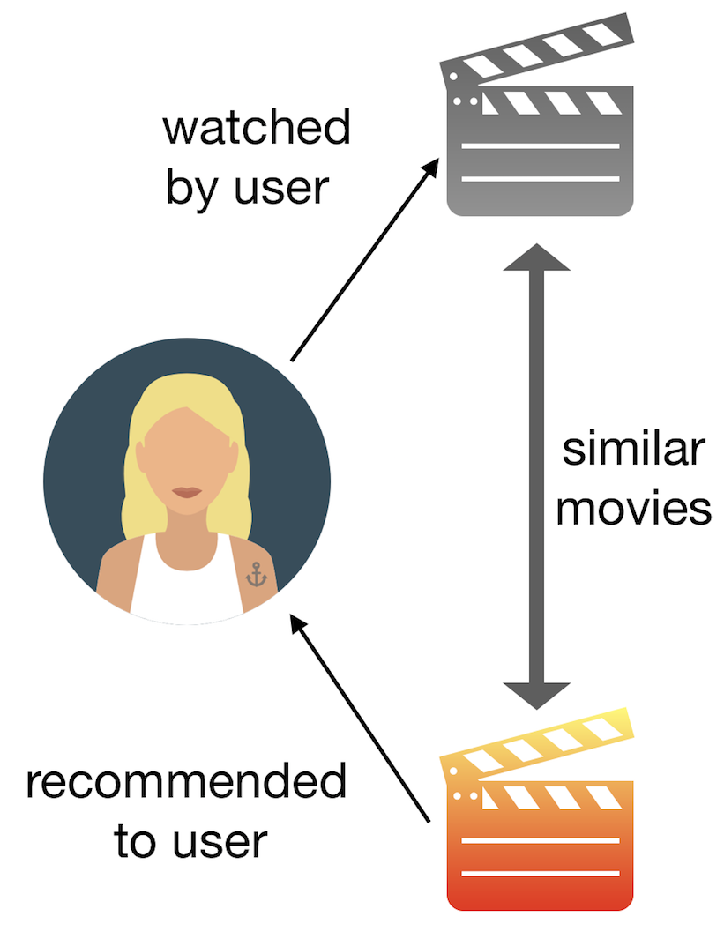
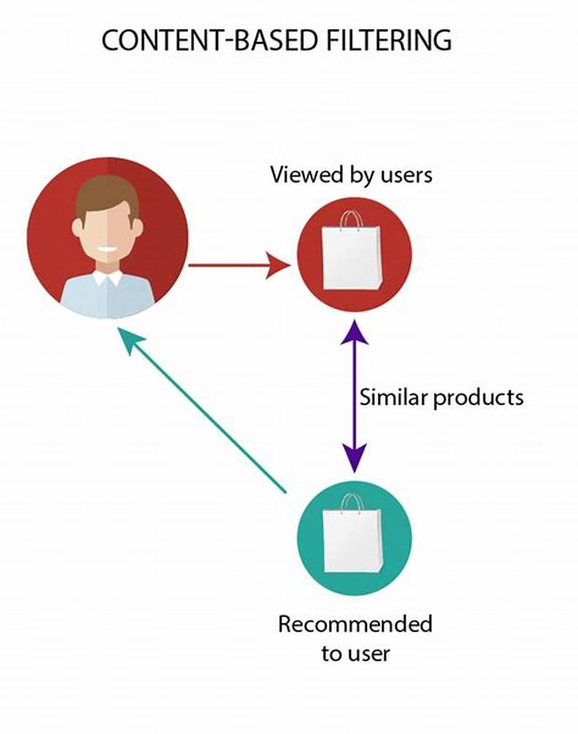
EXAMPLES

Slide 5
MOVIE RECOMMENDATION
As recently expressed, a suggested framework is given as info a bunch of appraisals of individual relics for a particular client in the social separating approach. On account of film proposals, for instance, this information would be a rundown of motion pictures that the client had seen, each with a number rating.
The recommendation system's output is a new group of artefacts that the user hasn't yet scored but that the recommendation system believes the user will like.
This problem would be solved by social-filtering systems focused entirely on each user's movie ratings and computing a function from these appraisals can give a client a rating for a film that others have evaluated yet the client has not. Rather than a binary label, these methods have generally produced movie ratings.
They come up with ratings for unseen objects by comparing people's preferences for the rated items. Individual users of a system make similarity judgments, which are computed using several statistical methodologies. Recommender, for instance, ascertains a more modest gathering of reference clients known as the recommenders for each user.

Slide 6
THEORETICAL ANALYSIS
Basic Requirements:
PC or Laptop
Jupyter Notebook (Anaconda)
Python (Programming Language)
Modules & Libraries in Python
Datasets (movies.csv & ratings.csv)

Slide 7
DATASETS
We will utilize a public informational index for film appraisals from Grouplens.org. It’s a compressed document from which I have separated two records for this activity. The crude records are in GitHub as ratings.csv and movies.csv.
This information is a subset of a bigger film focal point informational collection that was utilized to fabricate a cross breed film proposal framework, conveying both substance and shared separating. movies.csv contains 9742 motion pictures from 600 clients, ratings.csv has 100836 film appraisals.
Dataset 1: movies.csv
This dataset comprises 9742 films and 3 columns.
Dataset 2: ratings.csv
Ratings dataset is a combination of 600 users and each user review on the different movies which sum up a total of 100836 ratings. This dataset has 4 columns:

Slide 8
EXPERIMENTAL INVESTIGATIONS
COSINE SIMILARITY:
Cosine comparability is a measurement used to gauge how comparable two things are. Numerically, it estimates the cosine of the point between two vectors projected in a multi-dimensional space. The output value ranges from 0–1.
0 means no similarity, whereas 1 means that both the items are 100% similar.
The python Cosine Similarity or cosine portion processes likeness as the standardized speck result of info tests X and Y. We will utilize the sklearn cosine likeness to track down the cos for the two vectors in the counting network.
For instance, the cosine comparability between film 0 and film 1 is 0.105409 (a similar score between film 1 and film 0 request doesn't make any difference). Motion pictures 0 and 4 are more like one another (with a similitude score of 0.23094) than films 0 and 3 (score = 0.0377426). The inclining with 1s proposes what the case is, every film x is 100% such as itself.

Slide 9
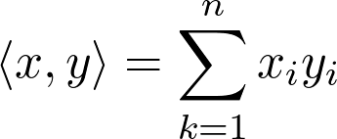
DOT PRODUCT:
The dot product is important when defining the similarity, as it is directly connected to it. The definition of similarity between two vectors u and v is, in fact, the ratio between their dot product and the product of their magnitudes. The dot product between two vectors is equal to the projection of one of them on the other. Therefore, the dot product between two identical vectors (i.e., with identical components) is equal to their squared module, while if the two are perpendicular (i.e., they do not share any directions), the dot product is zero. Generally, for n-dimensional vectors.

Slide 10
Workflow of Content-based filtering
Content Based approach is based on the matching of user profile and some specific characteristics of an item. The principle thought behind CB Recommender Systems is that they proposed things that are like the ones previously evaluated with a high appraising by the objective purchaser.
The tech giants in the various fields of online business, entertainment, shopping like Amazon, Flipkart, Netflix, Alibaba. These organizations utilize distinctive recommendation systems, for example, content-based sifting, synergistic and different calculations. Netflix utilizes Netflix Recommendation System (NRE) which is content-dependent on every individual client profile. The motor channels throughout 3,000 titles all at once utilizing 1,300 proposal groups dependent on client inclinations. It’s so exact that 80% of Netflix watcher action is driven by customized suggestions from the motor. It’s assessed that the NRE saves Netflix more than $1 billion every year.
E-commerce organizations like Amazon, Flipkart utilize distinctive recommendation systems to give a newly added recommendation to clients. Amazon utilizes at present thing shared separating, which scales to colossal datasets and produces an incredible suggest dynamically. This technique is a sort of data separating framework which predicts the "rating" or inclinations that the customer is keen on.

Slide 11
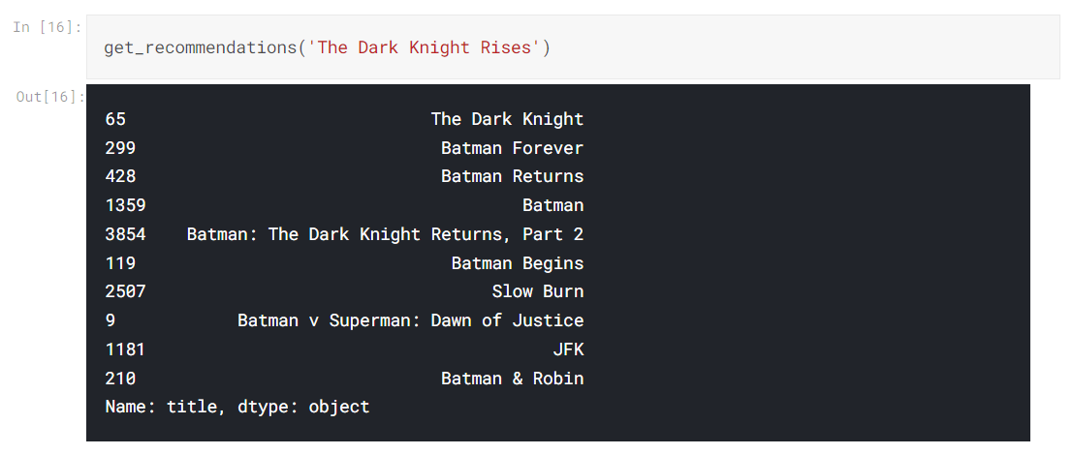
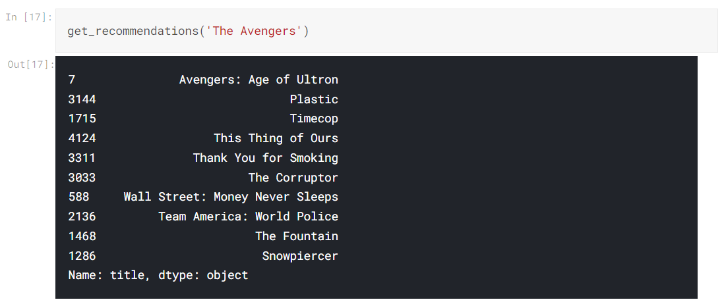
RESULTS

Slide 12
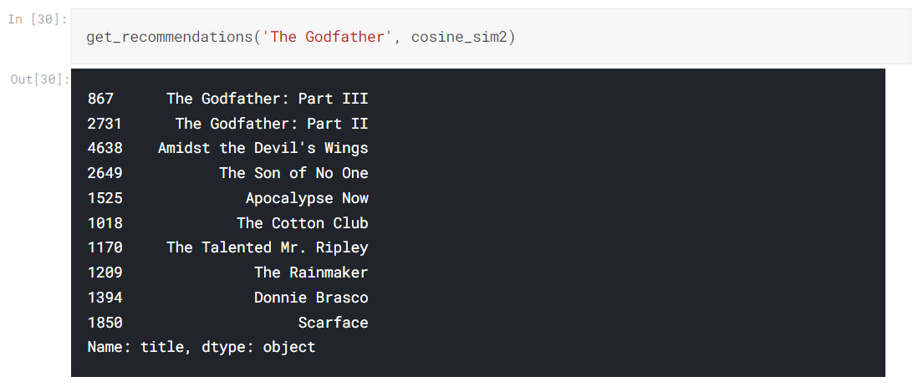
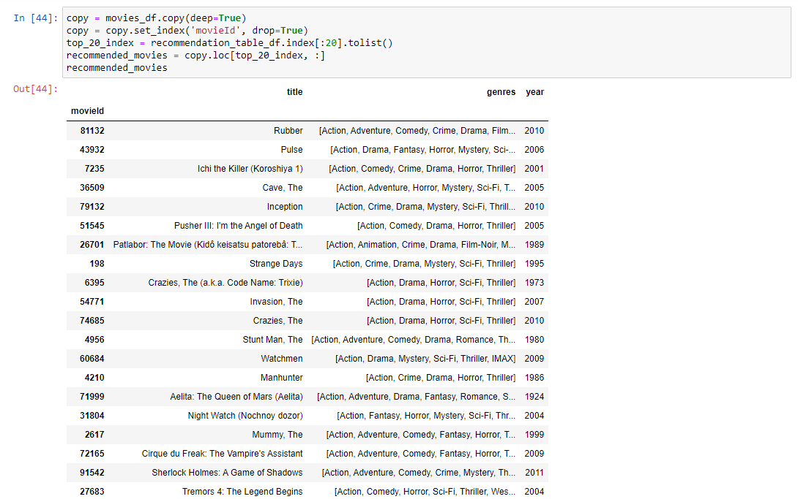

Slide 13
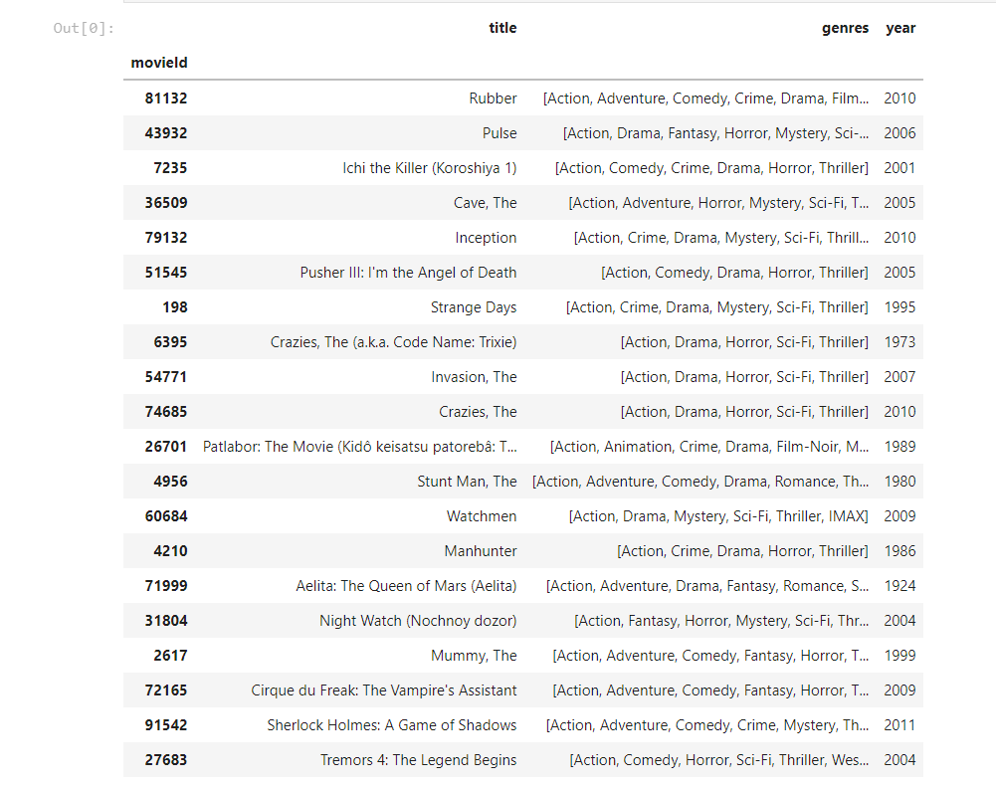
Discussion of Results
A section of the Each Movie dataset was used. This dataset contains 610 people who were chosen at random and 100836 movie ratings for which IMDb content was accessible. We have columns like movie_id, title, genre, and year in the Movies data set, and user_id, movie_id, and rating in the Ratings data set. We isolated the rating dataset into tests and prepared sets to evaluate different separating calculations. A subset of the ratings data from the Each movie dataset is used in the rating database. Utilizing a for the most part utilized mistake measure, the preparation set is used to anticipate evaluations in the test set.

Slide 14
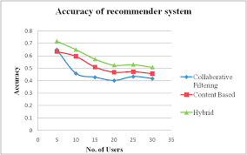
When compared to CBF and CF, we can observe that there are three sorts of filtering methods in which hybrid filtering accuracy is good, i.e., at the point when content-based and communitarian sifting strategies are joined.

Slide 15
We can also observe in the graph that:
1. Because Collaborative Filtering relies on overlap in ratings across users, the accuracy of the technique has deteriorated due to sparsity in ratings, i.e., a small group of people evaluating the same objects.
2. Because of its capacity to forecast out-of-box recommendations, Collaborative Filtering sometimes produced more relevant results.
3. Segment factors used to channel Content-based ideas have worked on the procedure's exactness.

Slide 16
CONCLUSIONS
E-commerce organizations like Amazon, Flipkart utilize distinctive recommendation systems to give a newly added recommendation to clients Amazon utilizes presently thing synergistic sifting, which scales to immense datasets and produces an incredible suggest dynamically. This strategy is a sort of data sifting framework which foresees the "rating" or inclinations that the customer is keen in.
The starting points of the substance-based suggestion system can be followed back to data recovery and sifting research. Consequently, it can be thought of as a natural extension and continuation of information filtering. However, the CB recommendations outperform typical information retrieval methods because, when information is acquired for the user, user preferences are also taken into consideration.
To achieve this accuracy, most memory-based methods and calculations were planned and refined here and there (e.g., kNN measurements, particular worth deterioration, and so forth) At the present time, half and half methodologies (principally collective sifting and content separating) are being utilized to work on the nature of the proposals. To accomplish this accuracy, most memory-based methods and calculations were planned and refined somehow or another (e.g., kNN measurements, solitary worth disintegration, and so on) At the present time, crossbreed draws near (primarily cooperative separating and content sifting) are being utilized to work on the nature of the proposals.

Slide 17
In the subsequent advance, calculations that acknowledged social contribution with before cross breed procedures were obliged and created (e.g., trust-mindful calculations, social versatile methodologies, interpersonal organizations investigation, and so on). Area information is by and by being incorporated into existing proposal frameworks utilizing half-breed calculations. Future exploration will focus on overhauling existing methodologies and calculations to work on the nature of recommender frameworks. For example, novel research lines will be developed in the following fields:
(1) Existing proposal frameworks that utilize different sorts of accessible information will be consolidated in a legitimate way.
(2) Processes for recommender systems ensure security and privacy. (3) Machine-controlled analysis of diverse data is facilitated by flexible frameworks.

